Slide 1
Online Retail Segmentation.
Beginner Queries.
Define meta data in mysql workbench
What is the distribution of order values across all customers in the dataset?
How many unique products has each customer purchased?
Which customers have only made a single purchase from the company?
Which products are most commonly purchased together by customers in the dataset?

Slide 2
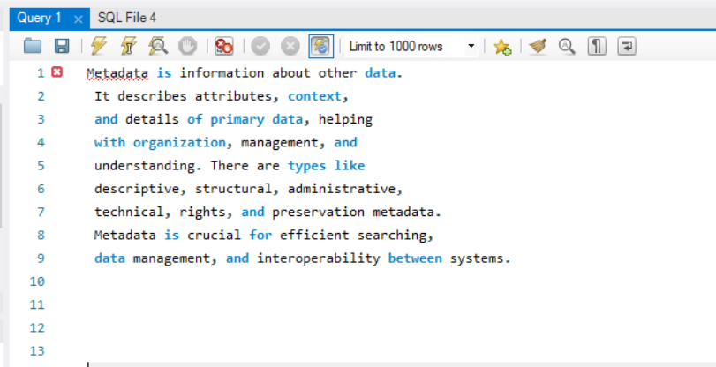
Define meta data in mysql workbench

Slide 3
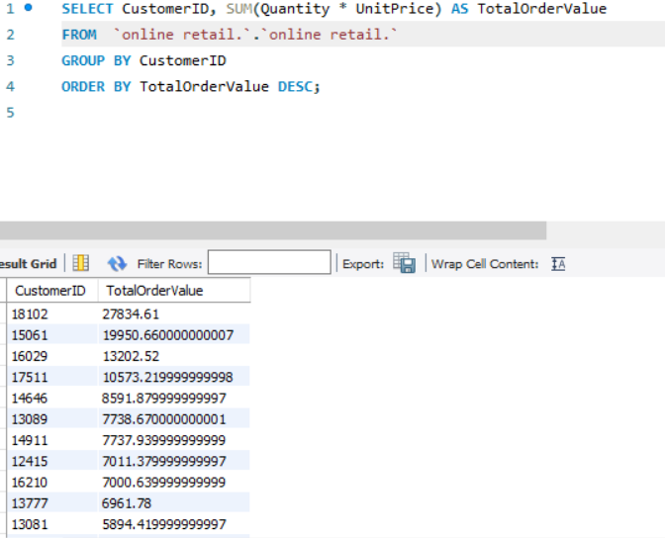
What is the distribution of order values across all customers in the dataset?

Slide 4
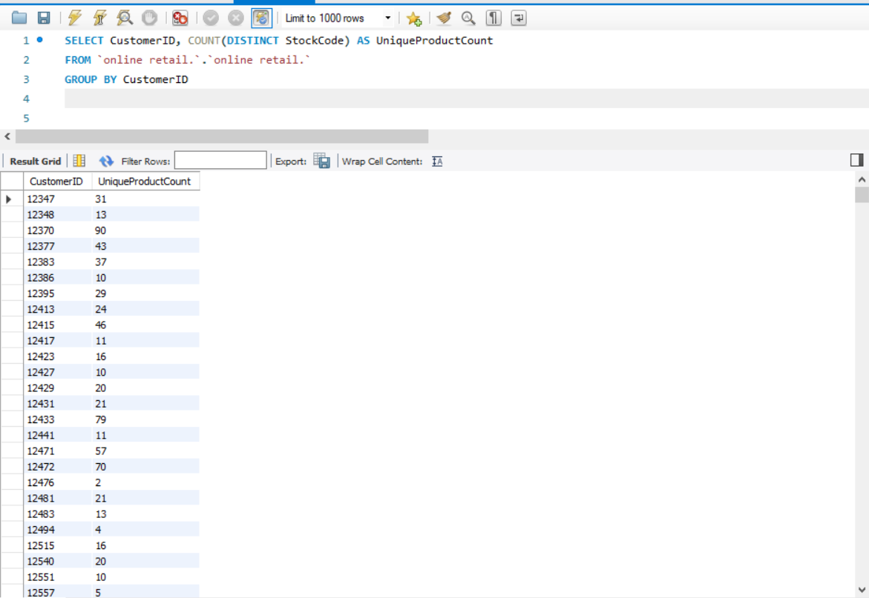
How many unique products has each customer purchased?

Slide 5
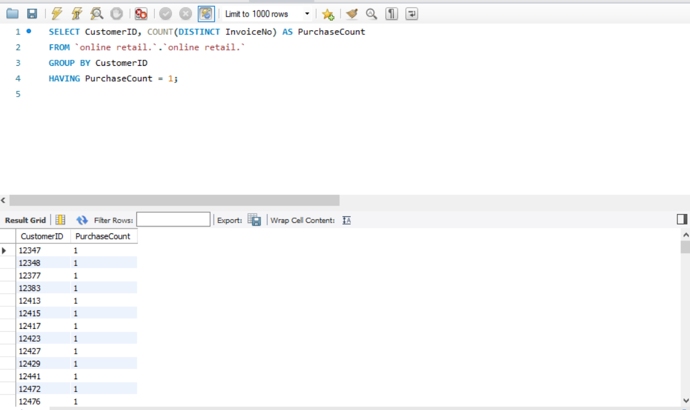
Which customers have only made a single purchase from the company?

Slide 6
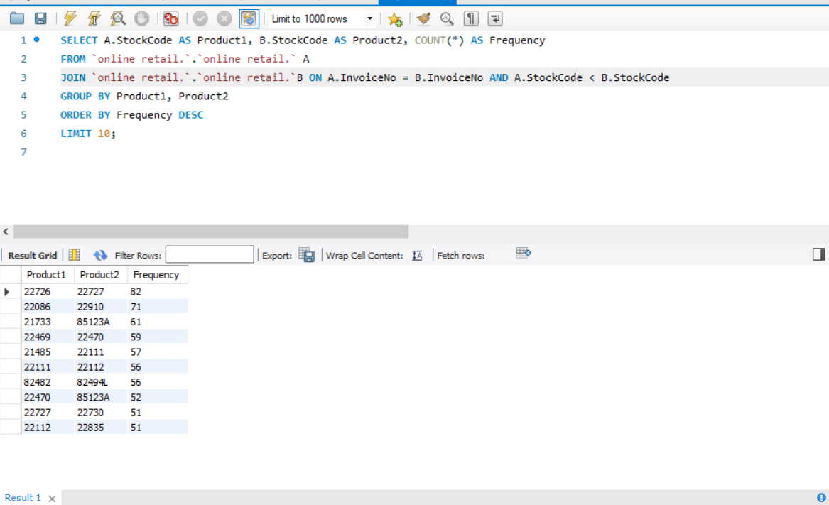
Which products are most commonly purchased together by customers in the dataset?

Slide 7
Advance Queries
Customer Segmentation by Purchase Frequency
Group customers into segments based on their purchase frequency, such as high, medium, and low frequency customers. This can help you identify your most loyal customers and those who need more attention.
2. Average Order Value by Country
Calculate the average order value for each country to identify where your most valuable customers are located.
3. Customer Churn Analysis
Identify customers who haven't made a purchase in a specific period (e.g., last 6 months) to assess churn.
4. Product Affinity Analysis
Determine which products are often purchased together by calculating the correlation between product purchases.
5. Time-based Analysis
Explore trends in customer behavior over time, such as monthly or quarterly sales patterns.

Slide 8
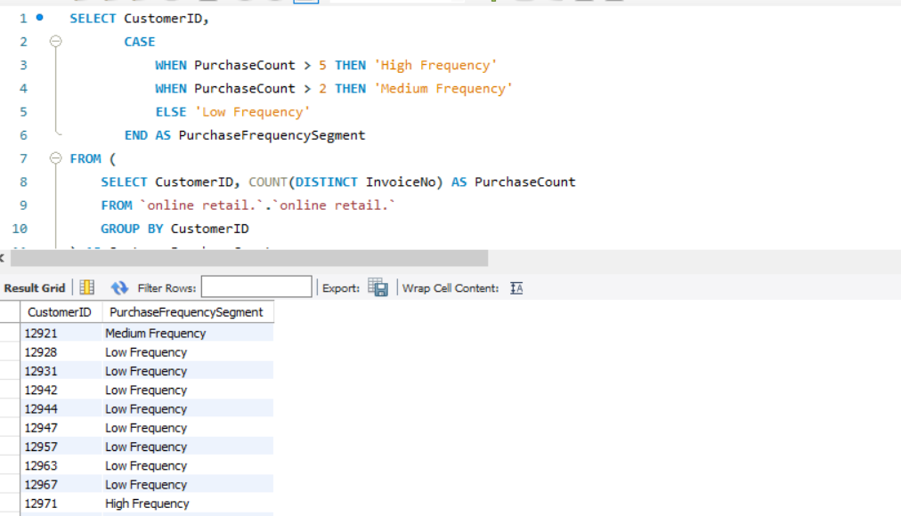
Customer Segmentation by Purchase Frequency Group customers into segments based on their purchase frequency, such as high, medium, and low frequency customers. This can help you identify your most loyal customers and those who need more attention.

Slide 9
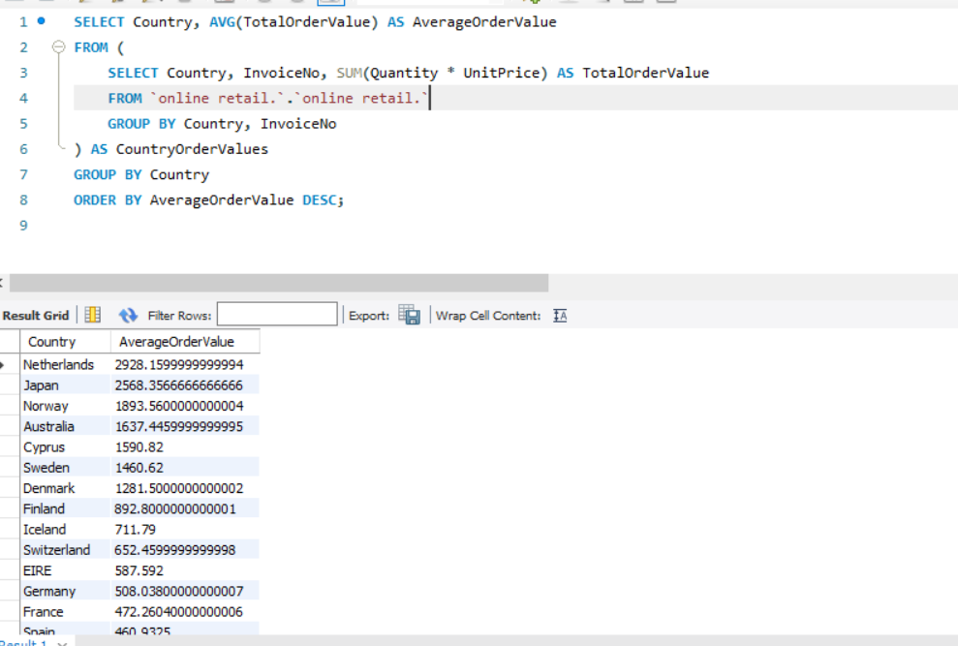
2. Average Order Value by Country Calculate the average order value for each country to identify where your most valuable customers are located.

Slide 10
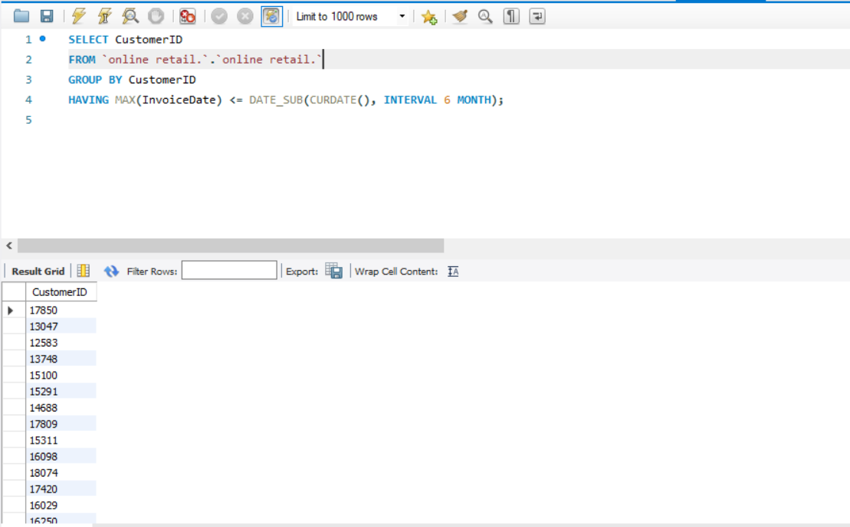
3. Customer Churn Analysis Identify customers who haven't made a purchase in a specific period (e.g., last 6 months) to assess churn.

Slide 11
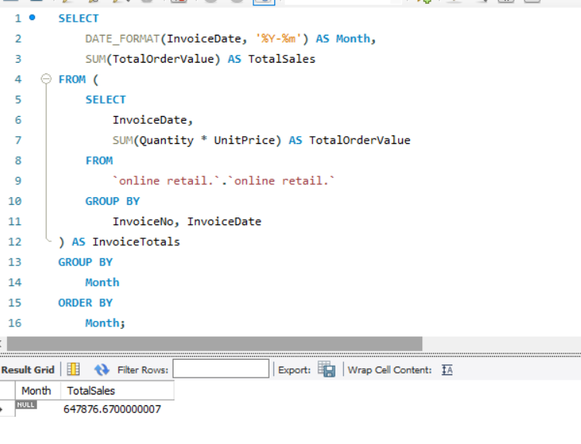
. Time-based Analysis Explore trends in customer behavior over time, such as monthly or quarterly sales patterns.

Slide 12
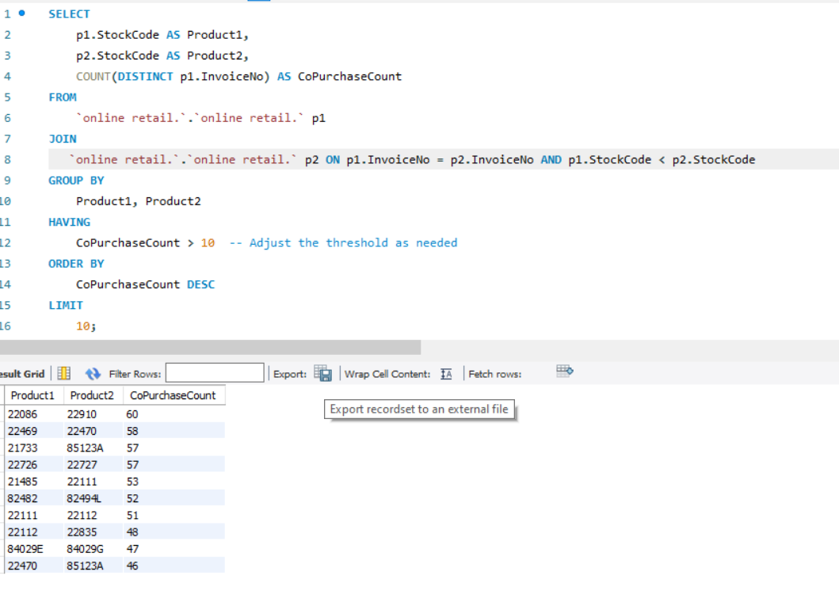
4. Product Affinity Analysis Determine which products are often purchased together by calculating the correlation between product purchases.

Slide 13
Github project link
https://github.com/itahamehdy/DSAI-Data-mining-.git

